Slide 1
Azure AI Foundry Masterclass | Build Gen AI apps and copilots
January 2025
Hicham Zmarrou & Jody Boelen

Slide 2
Introduction

Slide 3
Envisioned scenario shapes the application architecture
costumization and organization maturity
NLP Tasks
Human to AI Conversation
Agents to Agents’ Interaction and Action
Scenario
1
2
3
4
5
NLP/U & PLU tasks
Chat with your internal knowledgebase
LLM-Enhanced Chatbots
Copilots
Agents
Entity resolution ; Sentiment analysis; Completion ; text summarization; structured data extraction
Code completion; Functional business rules extraction from code; Business rules classification; Business rules standardization (e.g. SBVR)
Act as an AI Contract manager able to answer questions on procurement contacts .
Act as metadata expert able to answer metadata related question such as what does and business term means how it is related to another term and which data
Customer support, Customer experience , appointment setting
Type I embedded in enterprise software or SaaS applications such as GitHub Copilot, Copilot for Microsoft 365, etc.
Type II embedded in existing apps such those supporting specific business or IT flow
Integrate LLM agents in a supply chain management system to analyze data, make predictions about demand and inventory needs.
Include LLM agents in a financial trading platform to analyze market trends and provide investment recommendations.
Automation of a complex business or IT process.
Business Examples
Architectural Design Consideration
Prompt Engineering, Chaining
Function calling
Integration with existing data pipelines.
RAG
Prompt Engineering, Chaining, Guardrails, Personality
Integration with existing apps
RAG
Prompt Engineering, Chaining, Guardrails, Personality
Integration with existing apps
RAG
Prompt Engineering, Chaining, Guardrails, Personality
Integration with existing apps
RAG
Agents and multi-agent design
Plugins
Multi-Agents system

Slide 4
GenAI Powered apps share similar Lifecycle
Interact with the GenAI powered App
Align with
the dev team
Update app
Analyse feedback
Prioritise new ideas
Satisfying outcomes
Playground & experimentation
Novice User, analysts, developers
Develop, deploy and monitor GenAI powered apps
AI/software Engineers
Decision
Business Users
Evaluate & Feedback
.
.
Experiment different GenAI Models
Release app
Develop app
Orchestration, Configuration, Caching, Logging, Evaluate & Validation LLM
(Few-shots) Prompting, Advanced Prompting
Build & Package
Test the app
Try new ideas
Make decision
Business
IT
Business

Slide 5
SE1: NLP/PLU: call center’s conversation summarization, sentiment analysis, and structured transcription
BEFORE
AFTER
Specialized NLP Model Development: The data science team develops, deploys, and maintains machine learning models tailored for individual NLP tasks such as depersonalization, contact classification, and emotion detection.
Insight Extraction from Communications: Chats, call transcripts, and emails are analyzed using these models to extract the necessary insights.
Integration of Model Outputs: The insights from these models are made actionable through their integration into operational systems, facilitating informed actions.
Specialized NLP Model Development: The data science team develops, deploys, and maintains machine learning models tailored for individual NLP tasks such as depersonalization, contact classification, and emotion detection.
Insight Extraction from Communications: Chats, call transcripts, and emails are analyzed using GenAI/Azure OpenAI to extract the necessary insights.
Integration of Model Outputs: The insights from these models are made actionable through their integration into operational systems, facilitating informed actions.

Slide 6


SE2: Chat with your internal knowledgebase: AI contract manager
Company’s procurement, contracts database
1
Preprocess all contracts
Data preparation
Chabot
Web app
User query
Document Embedding
2
Query and
embedded query
Prompt + query + retrieved enhanced context
User query moderation, Information retrieval,
Response generation
Please show me all contract details for contract X
Generate a summary of this contract same contract and compared with a contract of x years before
Search and extract from the repository the related contracts to the processed contract according to its category, its organization, its subject, …
Streamed text response (Generative)

Slide 7

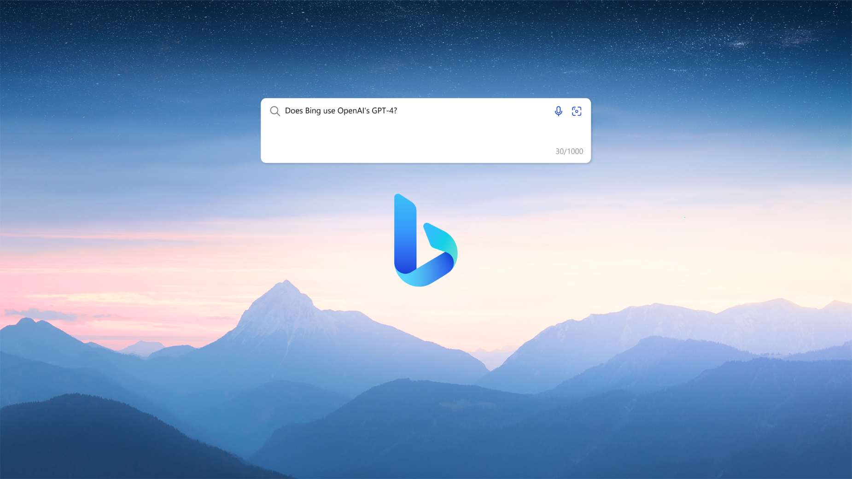
SE3: LLM Enhanced Chatbot
Finn: Bunq’s AI powered personal money assistant
Bing Chat: Real-Time AI-Enhanced Browser Interactions

Slide 8
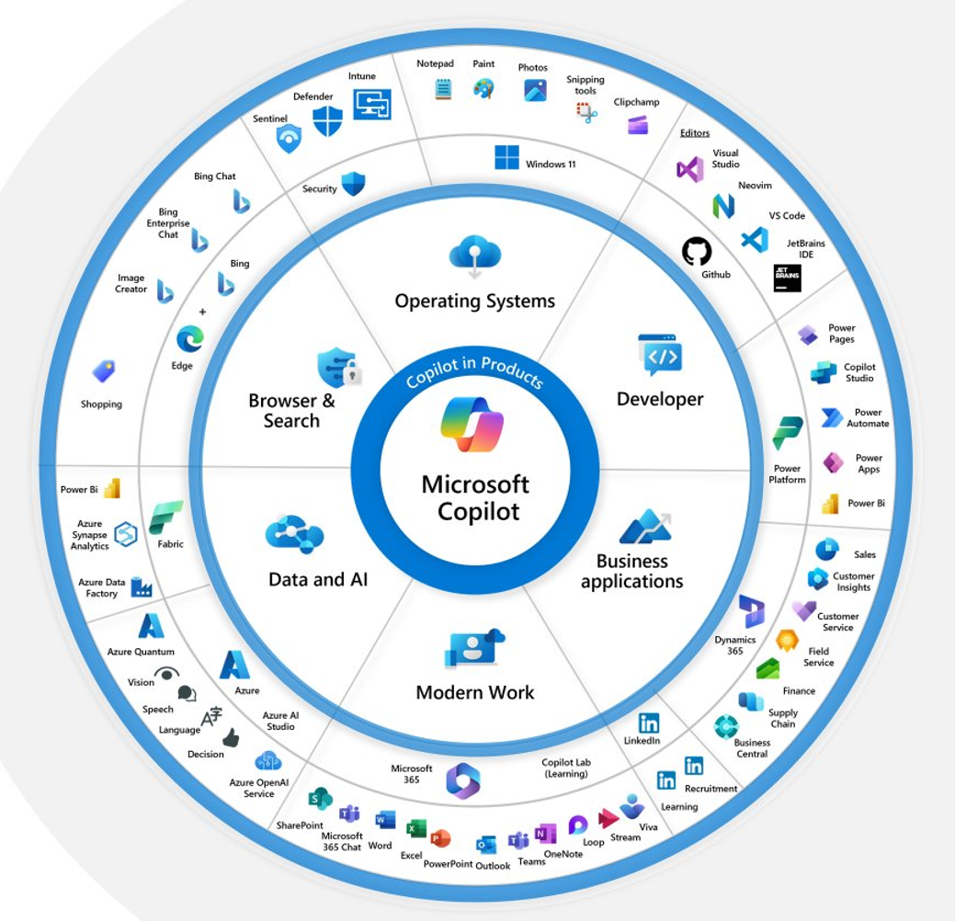
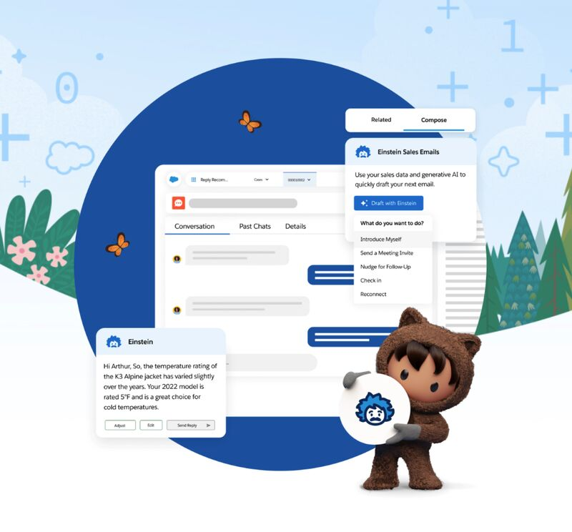
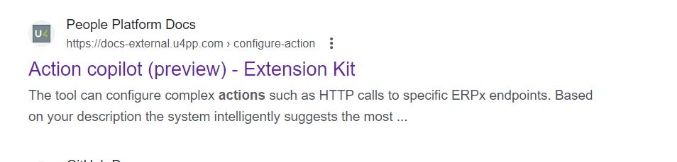
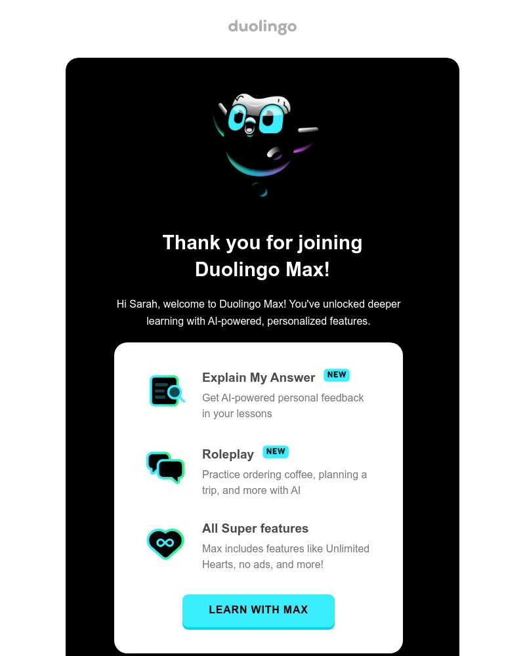
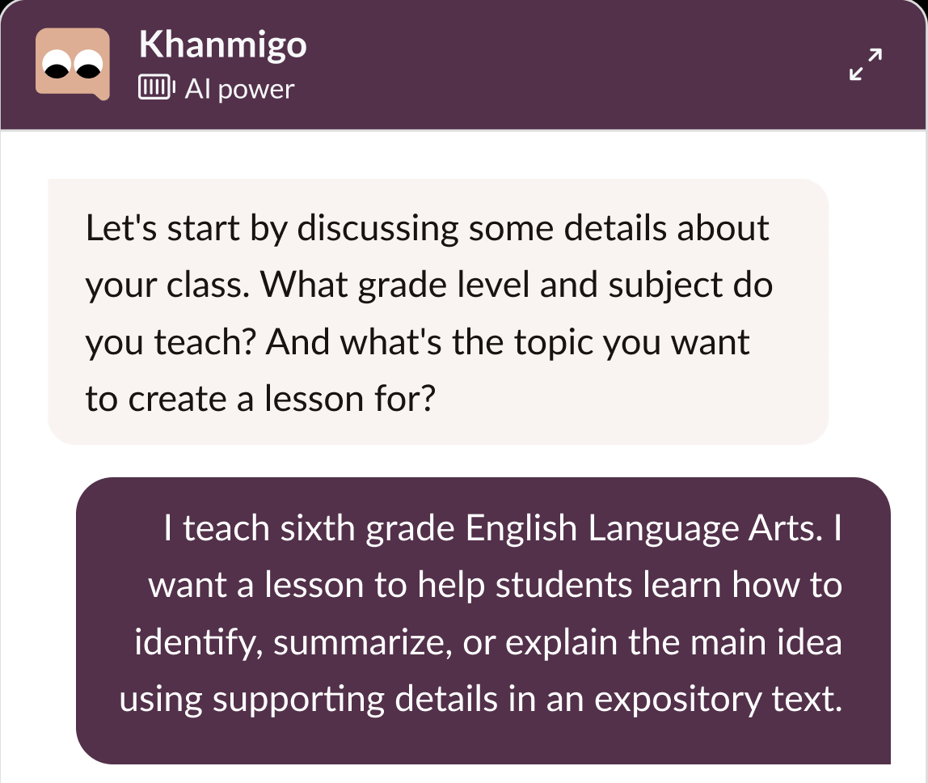
SE4: Example of scenarios: Copilots
Microsoft Copilots embedded in Microsoft products
Copilot embedded in other SaaS solution: Salesforce Einstein
Build your own copilot or AI assistant

Slide 9
SE5: Example of scenarios: Autonomous Agents
Current proof of delivery (POD Badger)
Yes
Human Agent
Retrieve the POD and send it to the requester
Requesters
Human agent
Human Agent
Human Agent
Request status of their goods through emails and chat
Read and understand requests
Query internal systems if POD exists
Initiate contact with the carrier to request the POD
No

Slide 10
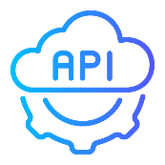

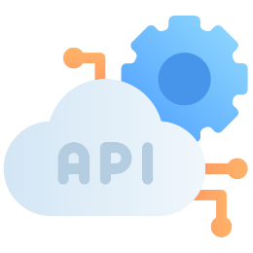
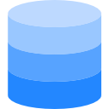
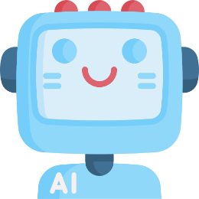


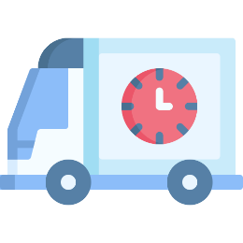
SE5: Example of scenarios: Autonomous Agents
AI powered proof of delivery (POD Badger)
ML model dedicated to forecast the delivery Millstones
6
If information is not complete, get forecast time for millstones through an online ML model API
1
Emails repository with all POD update requests
Read, analyses unstructured emails and chat and accurately interpret inquiries
Proof of Delivery agent
4
3
Requesters
Understand questions related to load, tracking, or delivery order numbers
Consult the shipment Details API
2
System DB
7
5
If no POD email the Carriere to get actual information on of the order
Update requesters with (predicted) delivery time

Slide 11
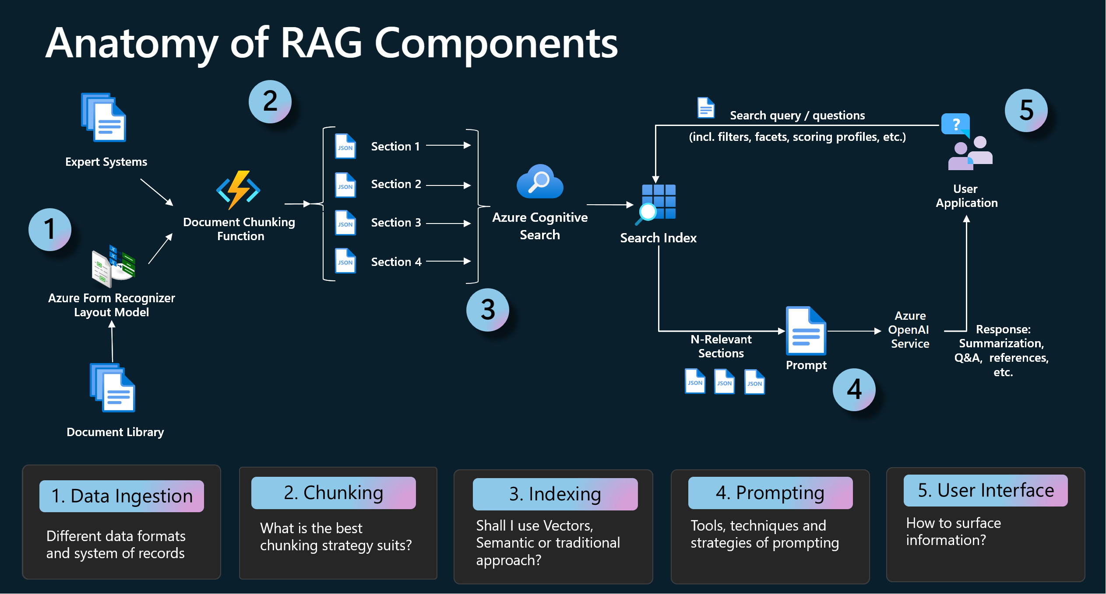

Slide 12
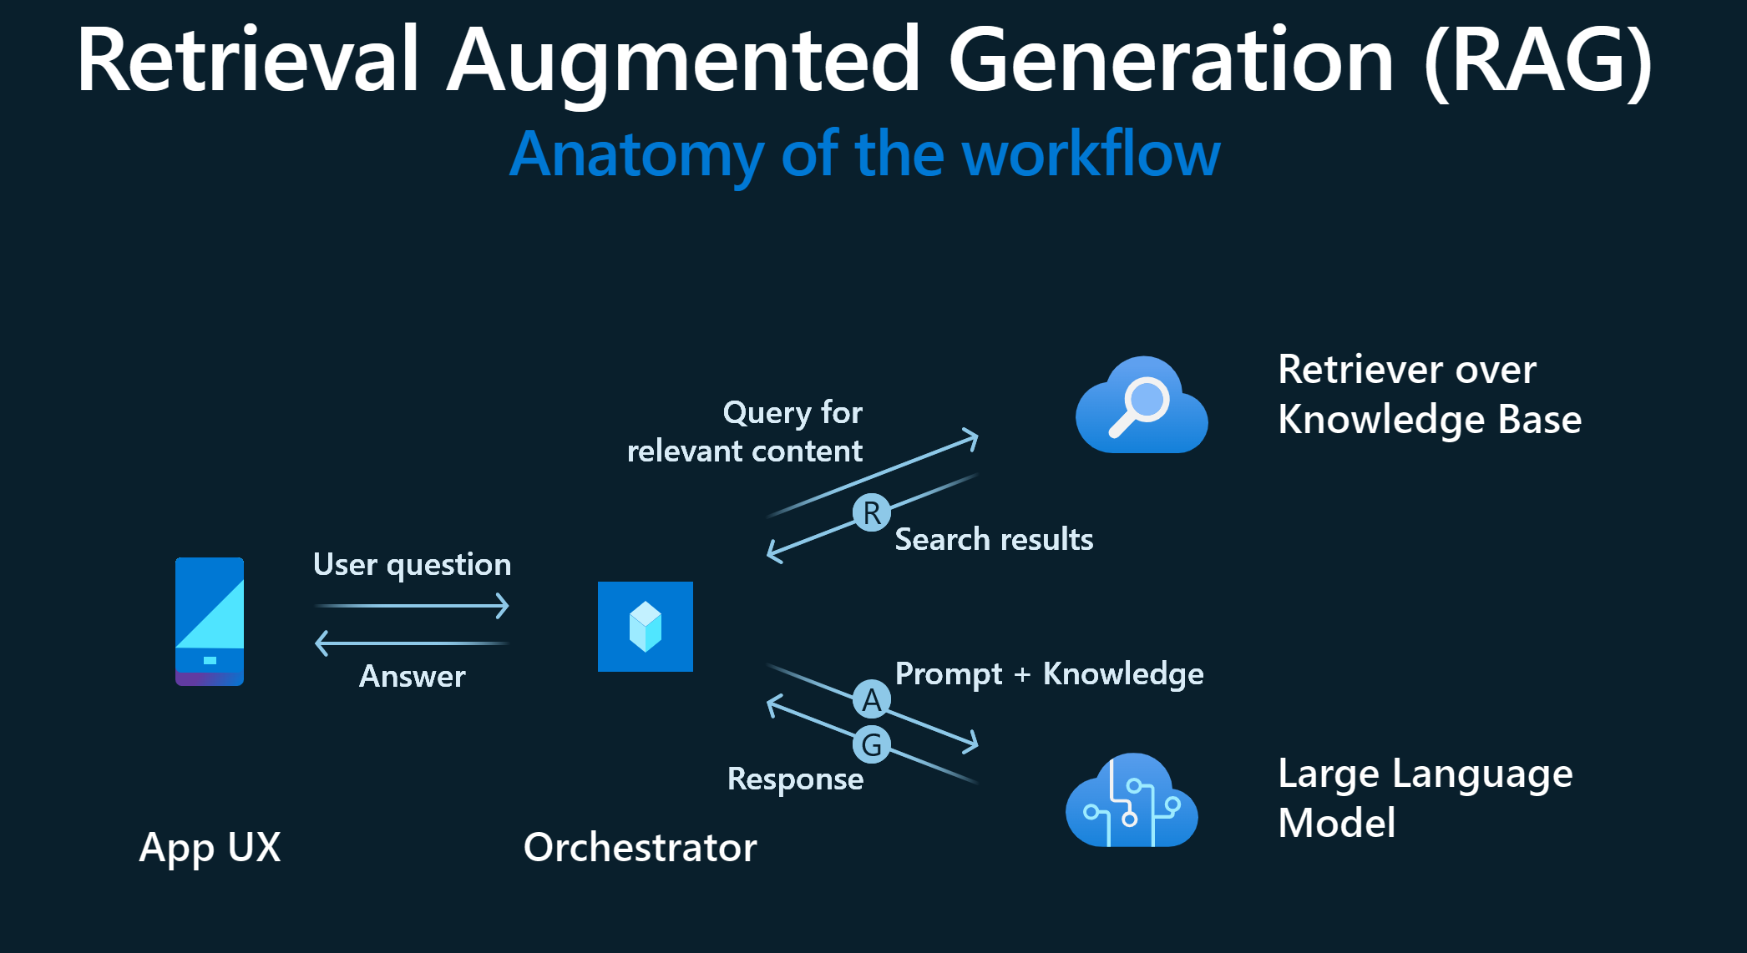

Slide 13
Azure AI Foundry

Slide 14
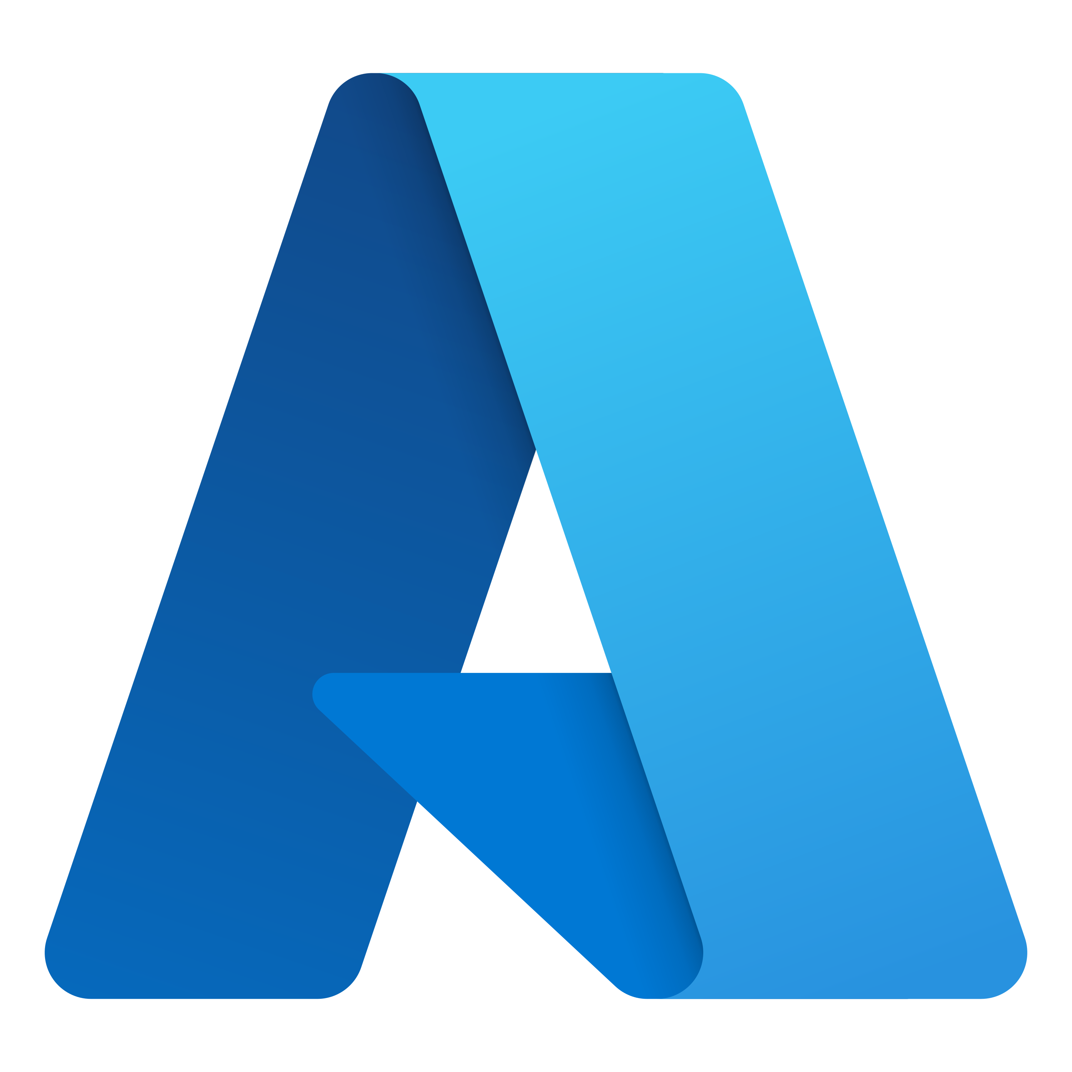

Purpose of Azure AI Foundry
Organizations aim to securely integrate GenAI into their daily operations
Azure AI Studio Features
Comprehensive Platform
Collection of AI models and services
Access to a wide range of LLM models via a single API
AI Services
Vision, document intelligence, translation, and more
Development Approaches
No code, low code, fully coded
Capabilities
Orchestration, deployment, monitoring, integration
Azure AI Studio
Platform for building AI tools: Copilots, apps, solutions, workflows
Security
Secure integration with your azure and on-prem environments
New solutions and advancements emerge daily across various platforms and sources
Custom GenAI solutions offer the best results but require diverse expertise, tools, and data integrations—from model selection to deployment and monitoring.
GenAI solutions are most effective when securely integrated with an organization's internal data and knowledge
GenAI solutions must be securely embedded in organizational business processes

Slide 15

Features of Azure AI Foundry
One-Stop Shop
Access to over 100 AI models and services
Unified billing for text generation, document transcription, text-to-speech, and more
Combine with data for context-aware applications
Integration with APIs, CRM systems, and more
Search web, Excel, SQL, and SAP data
Collection of great AI services and models at your fingertips
Complete AI Toolchain (search, data, web, functions, etc.)
Inclusive and Collaborative Platform
Supports low/no code with prompt flow orchestration
Advanced coding with APIs in VS Code and Python
Create and edit projects with team members
Inclusive platform (for all developers)
Collaborative environment
Production Ready and Enterprise Grade
Deploy AI applications across the organization
Trace, debug, and evaluate LLMs effectively
Integrate with Teams, Power Automate, and other apps
Monitor usage and costs
Production-ready and enterprise-grade
Tracing and debugging
Create once, deploy everywhere
Ecosystem Integration
Leverage Azure resources like virtual networks, private endpoints, storage and cognitive services
Easy deployment for Azure users
Project management

Slide 16
Guide to Building Impactful Applications with Azure AI Studio
To deliver an AI-powered application, you must first set up your development environment correctly. Next, it's essential to understand the various building blocks of Azure AI Studio, which will enable you to develop, deploy, and integrate your applications effectively. Finally, focus on tailoring the application for the end user to ensure it provides real value and usability.
Introduction
Next Steps
Environment Setup
Build an app with AZ AI Studio
AZ AI Studio Building Blocks
Introduction
Discuss next steps
Introduction to the course and Azure AI Studio, including its distinction from Copilot Studio and integration with Azure architecture
Collaborate on selecting and implementing the right technology to create value
Environment
Build an app
Importance of setting up the environment correctly to follow along, including deploying an AI hub, a project, and a Jupyter notebook
Building Blocks
Building and deploying comprehensive AI applications using opensource models and tools
Deploying models and testing them in Chat Playground.
Data indexing and integrating personal/company data.
Focus on prompt flow builder to create AI applications.

Slide 17
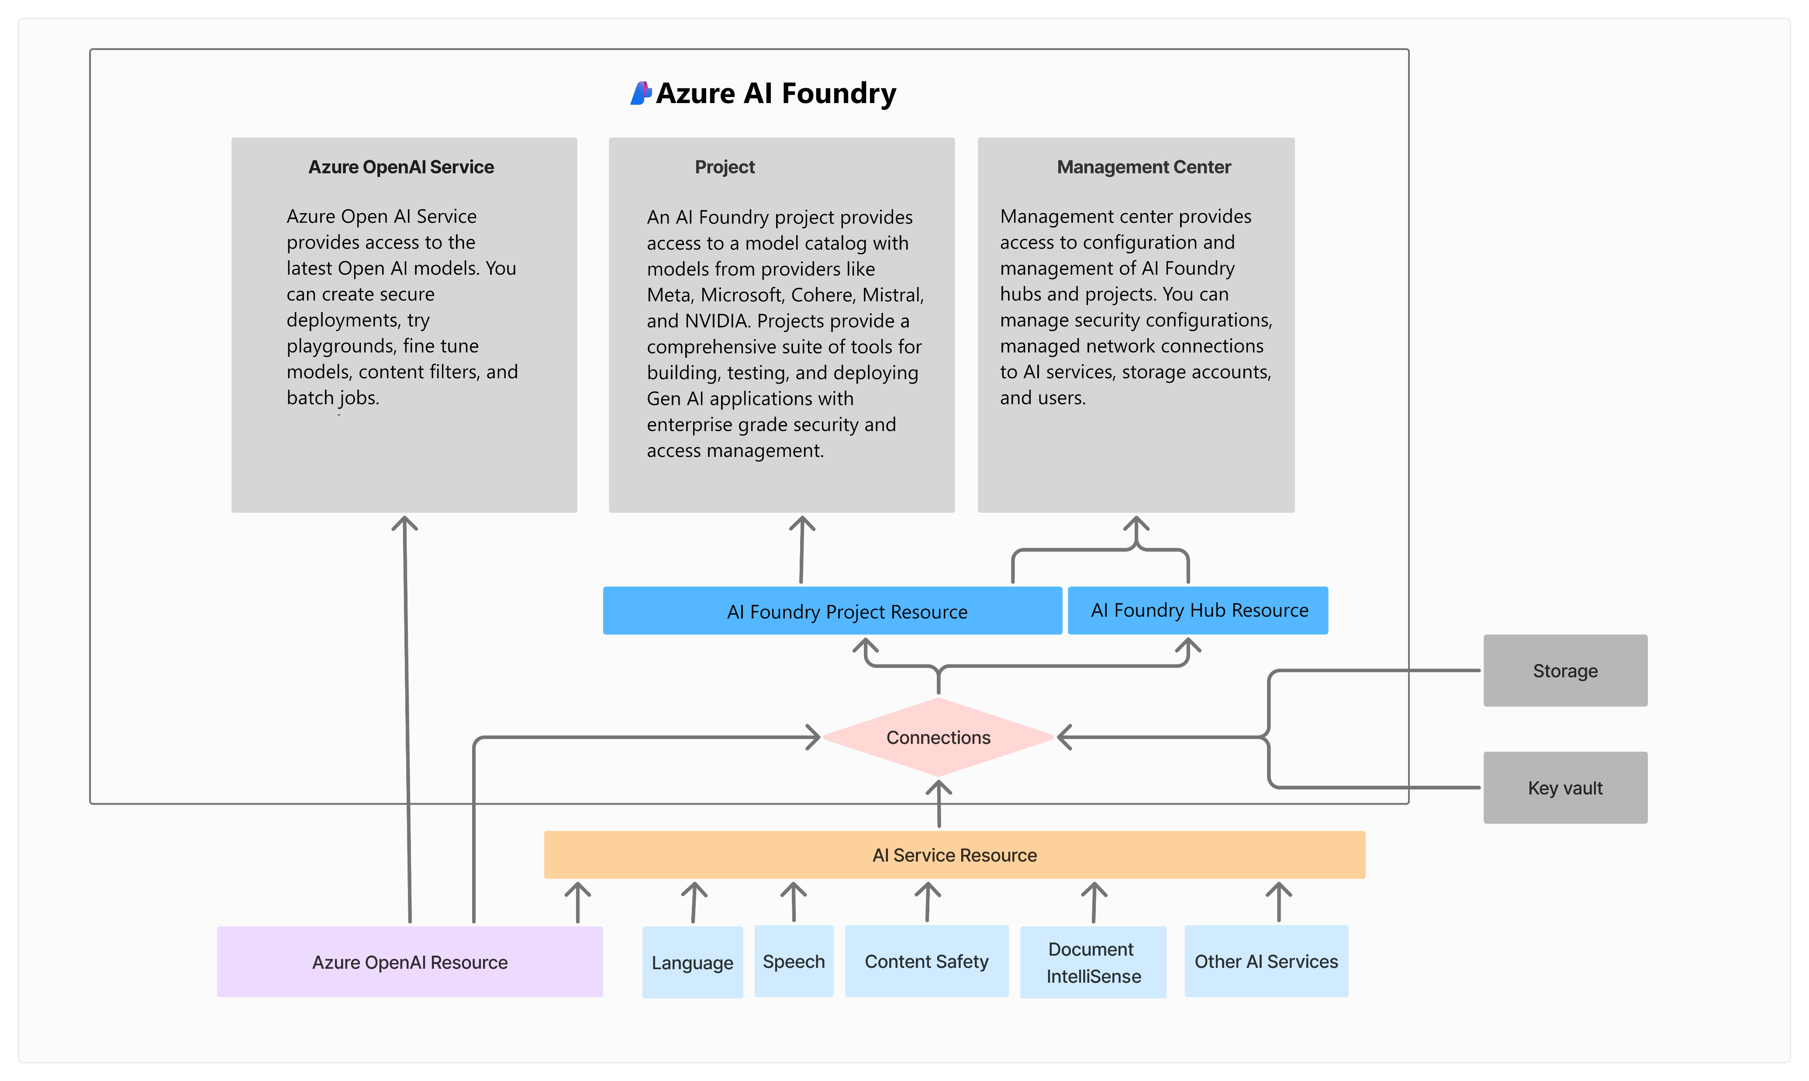
Azure AI Foundry Architecture

Slide 18
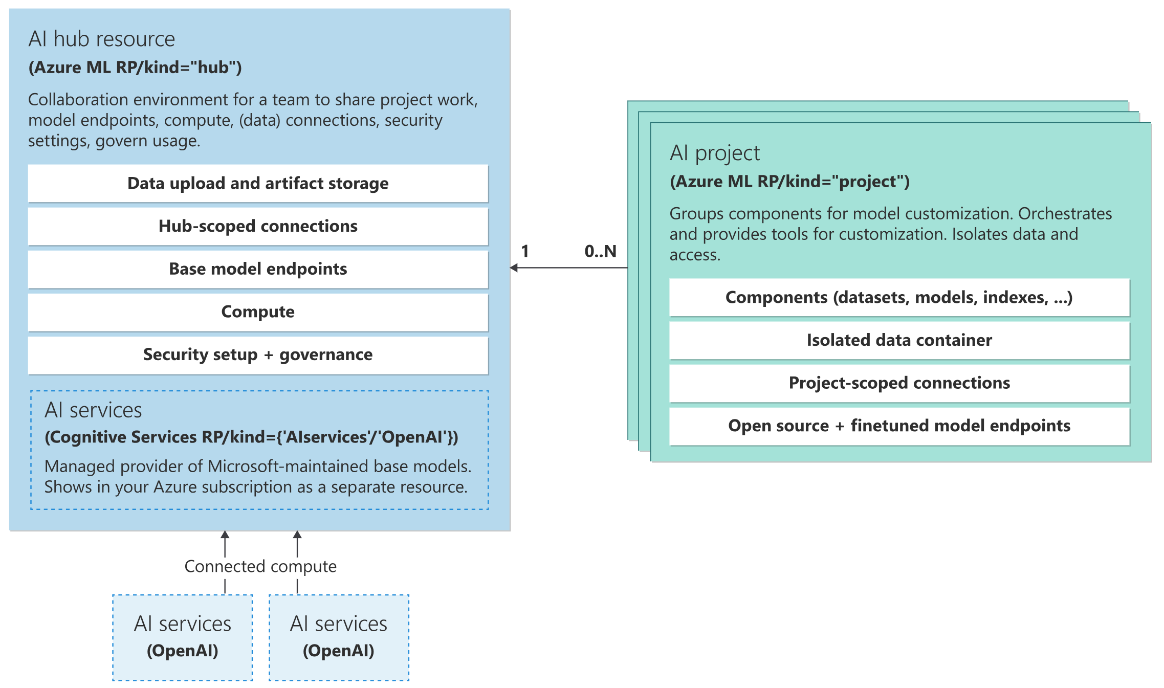
Azure AI Foundry Architecture

Slide 19
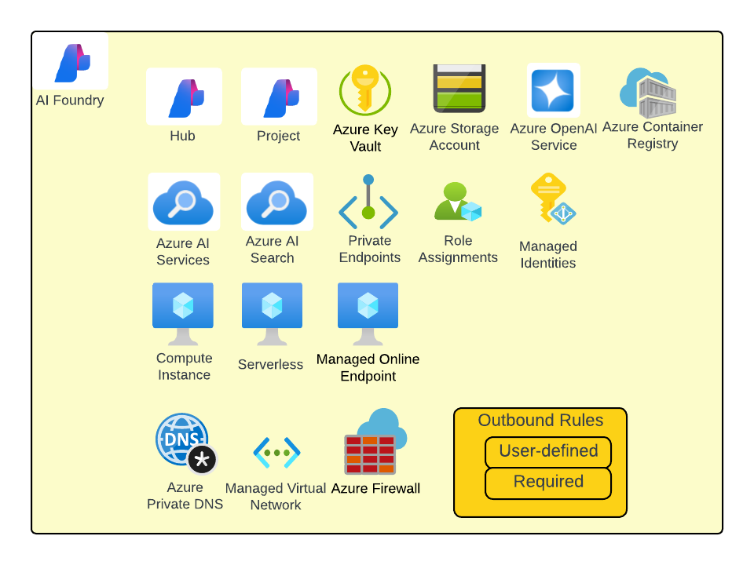
Azure AI Foundry Architecture

Slide 20
Resources
GitHub tutorials | https://github.com/MicrosoftDocs/azure-ai-docs/tree/main/articles/ai-studio/how-to
 | Open-source prompt flow: https://github.com/microsoft/promptflow
 | VS code prompt flow extension: Develop a dag flow — Prompt flow documentation (microsoft.github.io)
Video tutorials | Azure AI Studio - Complete Guide to Azure AI Studio (https://shorturl.at/VbdwQ)
 | https://www.youtube.com/watch?v=ra-AT0LZaCM

